Slide 1



OBJECT DETECTION
FOR AUTONOMOUS VEHICLE
USING YOLO V8
MARIA JASMINE E (URK22EC1057)

Slide 2
INTRODUCTION
Accurate and real-time object detection is an essential building block for achieving safe and reliable autonomous vehicles. This project delves into the application of deep learning techniques for object detection in autonomous vehicles. This will contribute to a more comprehensive understanding of the driving environment, enabling safer and more efficient autonomous navigation.

Slide 3
OBJECTIVE
Accurately identify and classify various objects on the road, including pedestrians, vehicles, cyclists, traffic signs.
Demonstrate robustness in diverse lighting conditions, weather scenarios, and complex road environments.

Slide 4
ULTRALYTICS
Ultralytics develops cutting-edge computer vision tools, particularly YOLOv8, a powerful model for object detection, segmentation, and more. Known for its speed and accuracy, YOLOv8 is available under open-source and commercial licenses. Ultralytics is making AI for computer vision accessible through advanced models and user-friendly tools.

Slide 5
OVERVIEW OF THE YOLO V8
YOLO V8 is a cutting-edge object detection algorithm that stands for 'You Only Look Once'.
It is known for its performance and high accuracy in detecting objects in images and videos.
The core of YOLO consists of a CNN responsible for extracting features from the input image.

Slide 6
FEATURES AND ADVANTAGES
It can detect multiple objects in a single pass, making it faster and more efficient than traditional object detection algorithms.
YOLO V8 also has excellent accuracy, achieving state-of-the-art performance on various benchmark datasets.

Slide 7

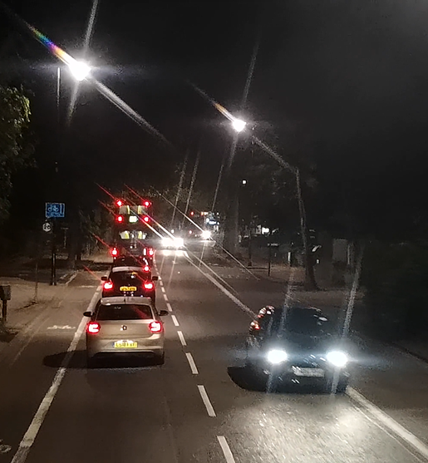
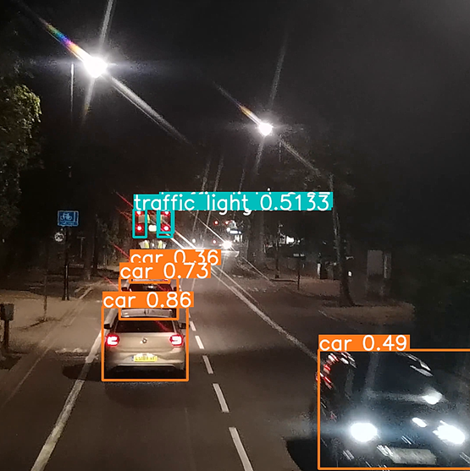

Result
INPUT
OUTPUT

Slide 8
THANK YOU

